Slide 1


Slide 2


Slide 3


Slide 4


Slide 5


Slide 6


Slide 7
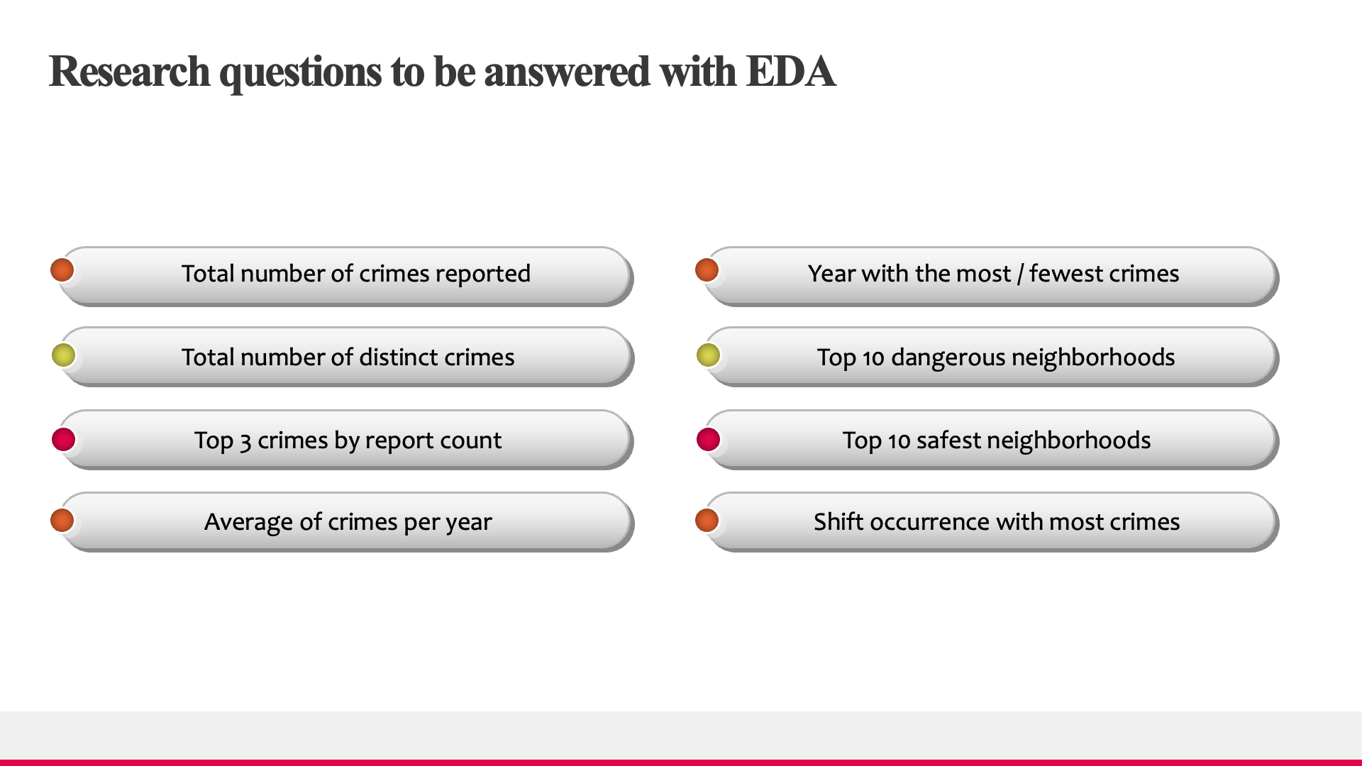

Slide 8
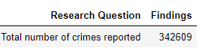
Question #1 - Total Number of Crimes Reported
Based on analysis, we found that there were 342,609 crimes committed in Atlanta from 2009 to 2019.
Note 1: Analysis based on Atlanta’s crime data from 2009-2019
Note 2: Deduped data on report ID

Slide 9
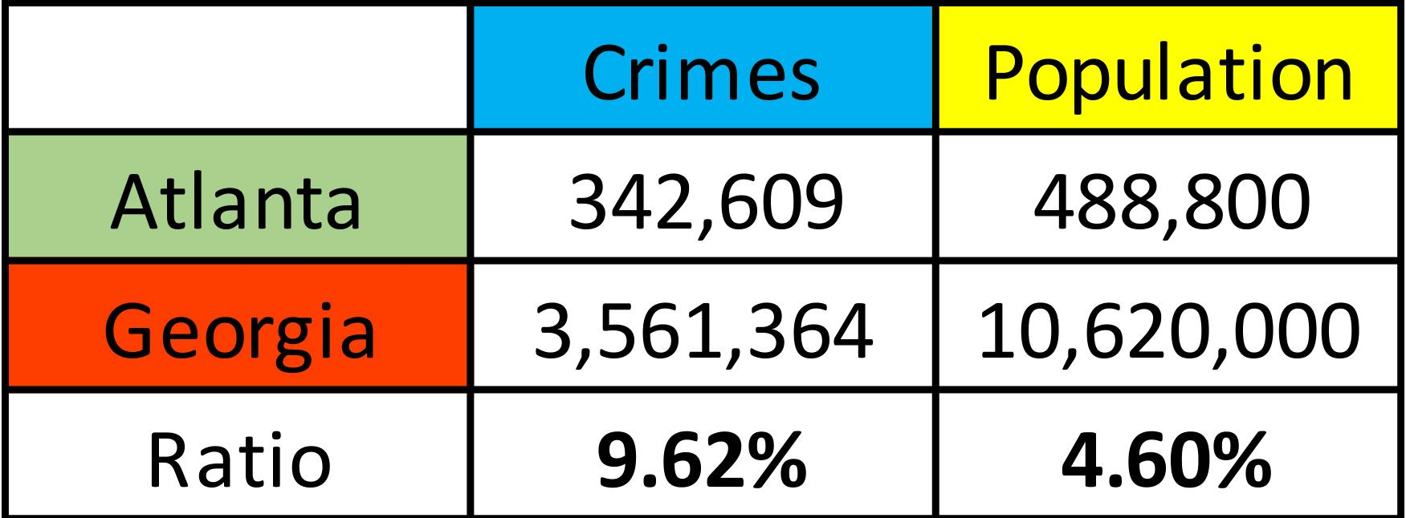
Question #1 - Total Number of Crimes Reported
Based on analysis, we found that there were 342,609 crimes committed in Atlanta from 2009 to 2019.
Note 1: Analysis based on Atlanta’s crime data from 2009-2019
Note 2: Deduped data on report ID

Slide 10
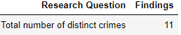
Question #2 - Total Number of Distinct Crimes
Based on EDA ( Exploratory Data Analysis ) :
There were 11 distinct crimes exist in Atlanta in the 10 year period from 2009 to 2019.
UCR ( Uniform Crime Reporting ) Literal.
Note: analysis based on Atlanta’s crime data from 2009-2019

Slide 11
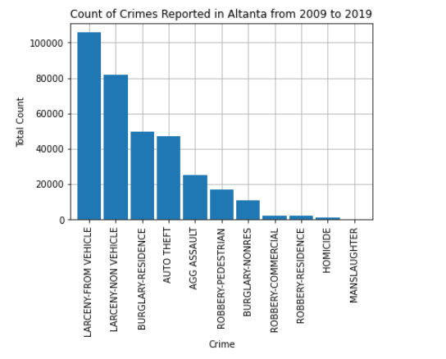
Question #3 - Top 3 crimes by Report Count
Analysis shows that the Top 3 crimes by report count in Atlanta are: Larceny-From Vehicle, Larceny-Non Vehicle and Burglary-Residence
Note: analysis based on Atlanta’s crime data from 2009-2019

Slide 12
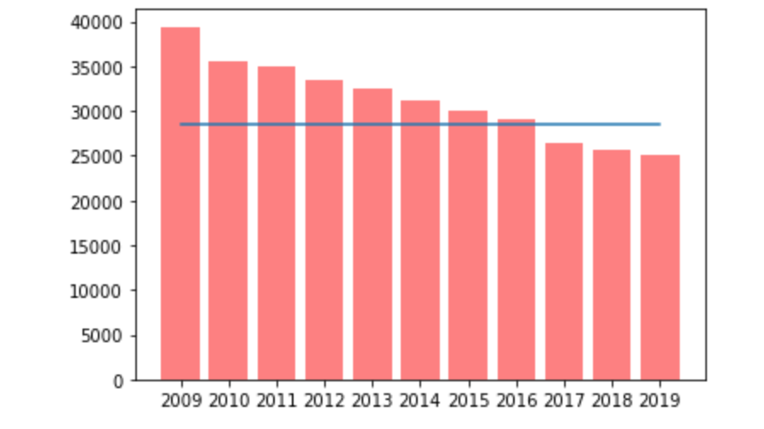
Question #4 - Average of crimes per year
Based on our analysis, we found that the average amount of crimes per year was 28,576 indicted by the blue line on the bar chart.
chart

Slide 13
Question #5 - Year / Date with the most / fewest crimes
2009 was the most dangerous year with 39395 cases of crimes.
November 17th, 2009 was the most dangerous day with 170 crimes committed.
2019 was the least dangerous years with 25030 cases of crime.
February 2nd, 2014 was the least dangerous day with only 21 crimes being committed.
Note: analysis based on Atlanta’s crime data from 2009-2019

Slide 14
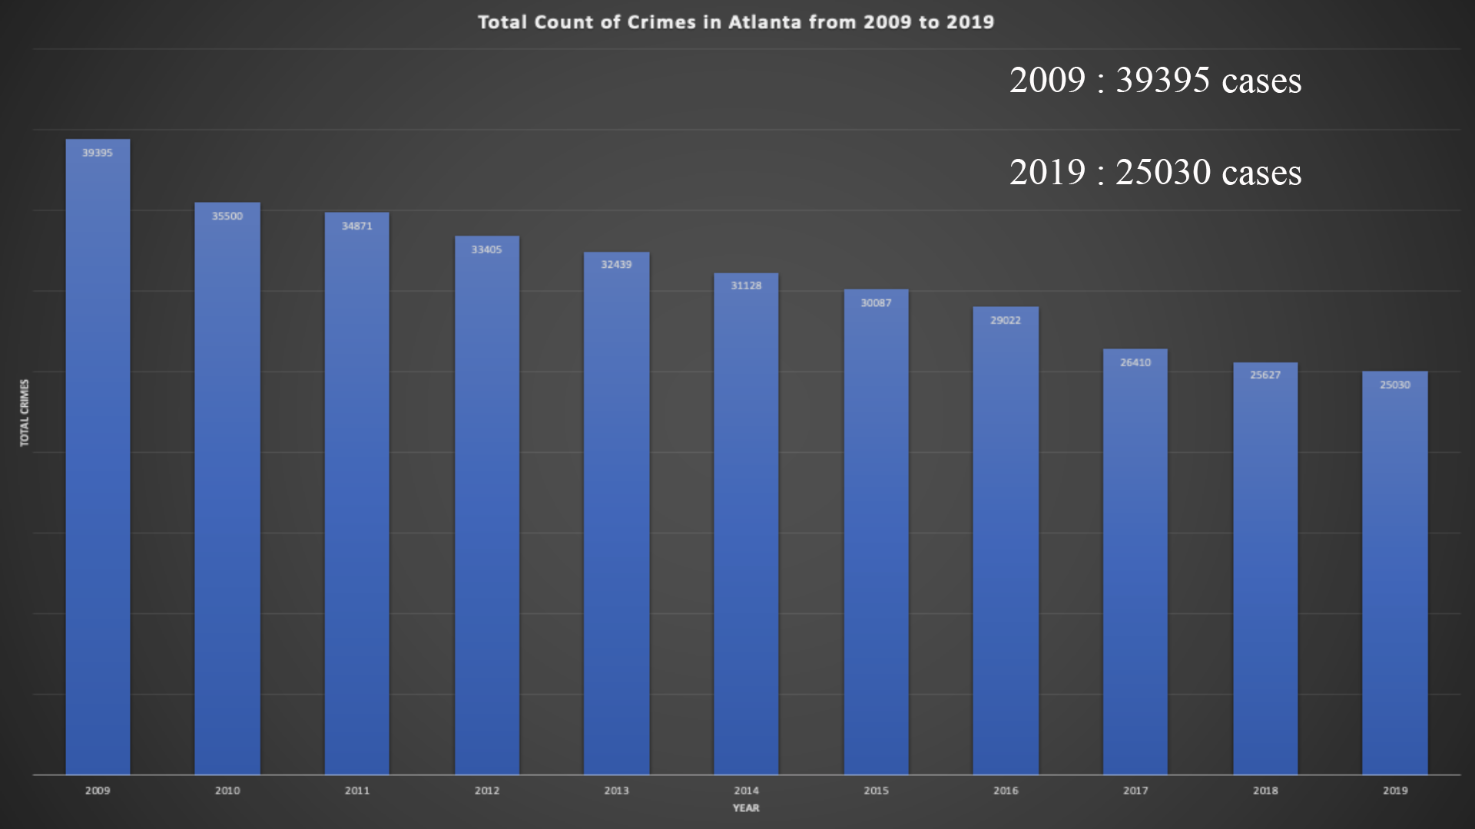

Slide 15
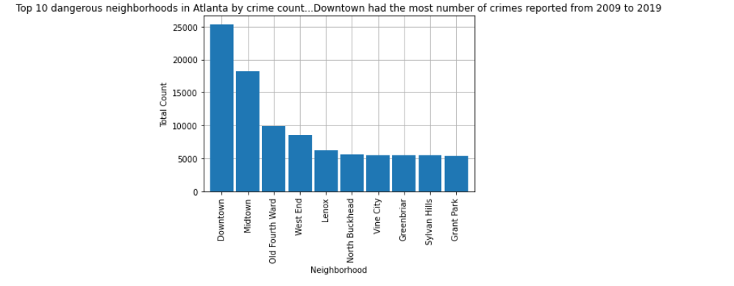
Question #6 - Top 10 dangerous neighborhoods
Analysis shows that the Top 10 dangerous neighborhoods in Atlanta are: Downtown, Midtown, Old Fourth Ward, West End, Lenox, North Buckhead, Vine City, Greenbriar, Sylvan, Grant Park.
Note: analysis based on Atlanta’s crime data from 2009-2019

Slide 16
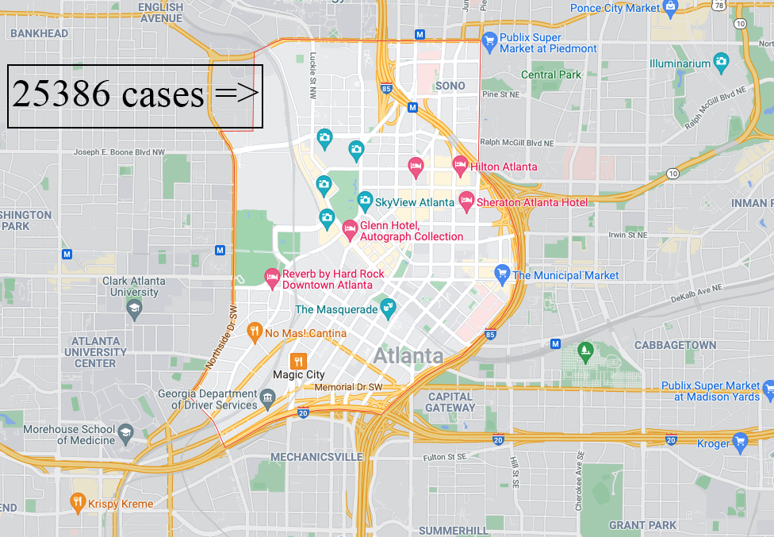

Slide 17
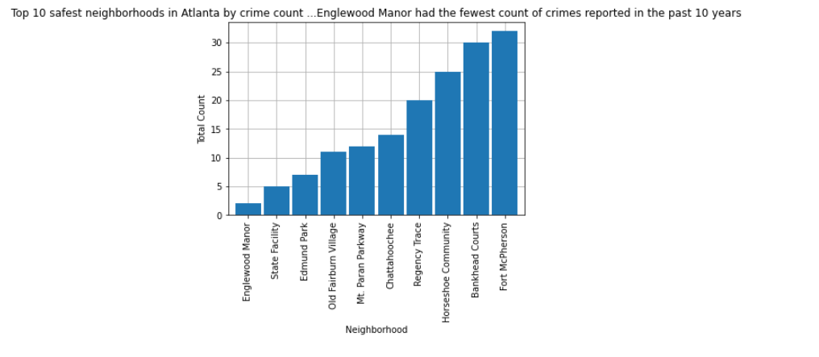
Question #7 - Top 10 safest neighborhoods
Analysis shows that the Top 10 safest neighborhoods in Atlanta are: Englewood Manor, State Facility, Edmund Park, Old Fairburn Village, Mt. Paran Parkway, Chattahoochee, Regency Trace, Horseshoe Community, Bankhead Courts, Fort McPherson.
Note: analysis based on Atlanta’s crime data from 2009-2019

Slide 18
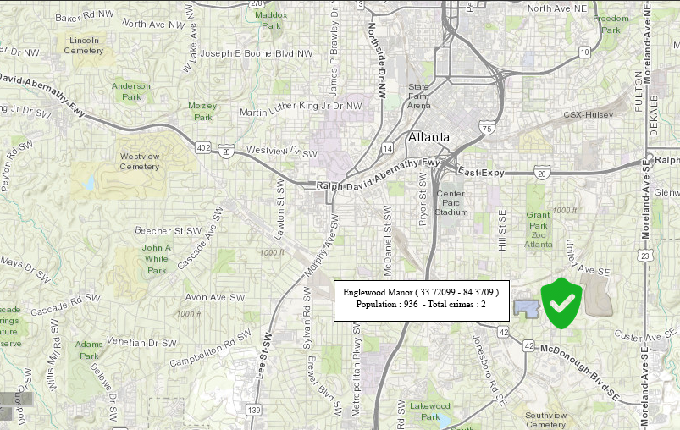

Slide 19
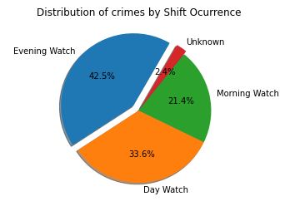
Question #8 - Shift occurrence with most crimes
Based on analysis done, group found that most of the crimes in Atlanta tend to occur during evening watch. Evening watch is typically 4 pm to 2 am.
Note: analysis based on Atlanta’s crime data from 2009-2019

Slide 20
Our Conclusions based on the EDA done
Atlanta is a dangerous city to live
Larceny-From Vehicle, Larceny-Non Vehicle and Burglary-Residence are the most common crimes
Downtown is the most dangerous neighborhood in Atlanta with a total of 25,386 crimes reported in a decade
Englewood Manor is the safest neighborhood in Atlanta with only 2 crimes reported in a 10 years period
Most of crimes tend to occur during evenings
The average amount of crimes per year was 28576
The date with the most crimes was November 17th, 2009
The date with the least crimes was February 2nd, 2014.
In general, crime decreased in Atlanta between 2009-2019

Slide 21


